Slide 1
PRESENTING A COMPARATIVE ANALYSIS FOR GRAMMAR ERROR DETECTION
- Shreyas Nikam , Raj Doshi, Sravani Namburu
Group 2

Slide 2
Problem Statement
Grammatical Error Detection is something that is employed in everyday life.
People have begun to use various grammatical tools and chrome-extensions to do their activities with more convenience and simplicity.
This project will undoubtedly target customers who wish to know whether or not their language is grammatically correct.
Input | Output
She see Tom is catched by policeman in park at last night. | 0 (Errorful sentence)
She saw Tom caught by a policeman in the park last night | 1 (Grammatically correct sentence)

Slide 3
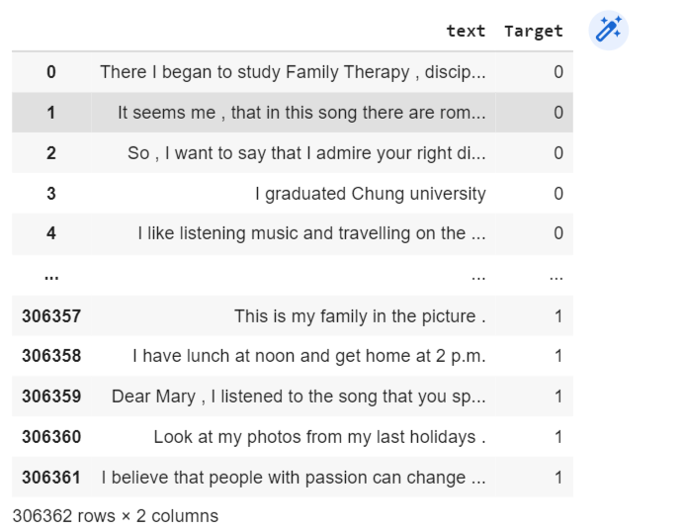
Dataset
This Dataset is obtained from Kaggle where it contains sentences which are correct and incorrect.
The Dataset contains 306362 data points for training and 38295 data points for testing.
The Dataset will be processed and merged together and mapped accordingly to 0 or 1 with respect to incorrect and correct sentences.

Slide 4
Approach:
Methodology:
Embedding using CountVectorizer, TFIDF-Vectorizer, Glove, and Fastext
Evaluate performance of Logistic Regression and Naive Bayes
Compare evaluation against LSTM, RNN and bidirectional models
Measure performance against state-of-the-art VERNet
Assessment: F_{0.5} score which assigns twice the weight to precision than recall since accuracy is more important than coverage for this task. Other than that, we plan to use F1 score, homogeneity, completeness, v-measure and rand index.
Ablation Study: Compare the models on different embedding techniques and try out different architectures.
Hypothesis: Bidirectional LSTM neural network will work best with Glove/Fastext embeddings.

Slide 5
Timeline
Week 9: Clean and pre-process our data and split between training and testing
Week 10: Implementing various embedding techniques and featuring the output into different models like Logistic Regression and Naive Bayes.
Week 11: Following up with week 10, LSTM, RNN and bidirectional models are implemented.
Week 12: Evaluating the models using internal evaluation metrics like F1 score, homogeneity, completeness, v-measure and rand index.
Week 13: Write the report.

Slide 6
Responsibilities
Shreyas: Logistic Regression and Bidirectional LSTM
Sravani: LSTM and RNN
Raj: Naive Bayes and Bidirectional RNN
Together: Preprocessing the data, evaluation and final report.

Slide 7
Related work:
Paper [1] presents a comparative analysis of the different neural network models used for error detection. We hypothesize that LSTM and RNN models would work better than simple classifiers for the described task.
Paper [2] presents the state-of-the-art Neural Verification Network for Grammar error correction with multiple hypothesis. We plan to compare the results of our approach against this pre-trained model for better understanding of the standing of our approach.
Paper [3] describes the drawbacks of existing simple metric evaluation methods and works towards building a new metric system for evaluation of grammatical error detection and correction.

Slide 8
References
[1] Marek Rei, Helen Yannakoudakis: Compositional Sequence Labeling Models for Error Detection in Learner Writing. CoRR abs/1607.06153 (2016)
[2] Zhenghao Liu, Xiaoyuan Yi, Maosong Sun, Liner Yang, and Tat-Seng Chua. 2021. Neural Quality Estimation with Multiple Hypotheses for Grammatical Error Correction. In Proceedings of the 2021 Conference of the North American Chapter of the Association for Computational Linguistics: Human Language Technologies, pages 5441–5452, Online. Association for Computational Linguistics.
[3] Mariano Felice and Ted Briscoe. 2015. Towards a standard evaluation method for grammatical error detection and correction. In Proceedings of the 2015 Conference of the North American Chapter of the Association for Computational Linguistics: Human Language Technologies, pages 578–587, Denver, Colorado. Association for Computational Linguistics.

Slide 9
Thank You

